Slide 1
Nuclear Power in Sweden
A Reformed Licensing Regime
EFELA Nuclear Congress, Milan, 3 September 2026
Mikae
Mikael Wärnsby
Partner – Energy & Environment, Advokatfirman Lindahl KB
M +46 730 39 92 50
Mikael.Warnsby@lindahl.se

Slide 2
Background: The Swedish Nuclear Programme
1970s–1980s: Sweden expanded nuclear capacity to 12 reactors.
1980 referendum: “yes” to existing programme and long-term phase-out.
1986: Prohibition to construct new reactors and to take preparatory steps.
1997 Phasing-out Act: enabled forced closure of individual reactors.
2009 Phasing-out Act repealed. Prohibition on new reactors lifted; replacement of existing reactors at existing sites allowed.
2016 Energy Agreement: Max 10 reactors at existing sites and no state support for nuclear energy.

Slide 3
Current Status
• Currently (2026), six (6) operating reactors.
• Located at three sites: Forsmark, Ringhals and Oskarshamn.
• Accounts for 30 % of Sweden’s electricity production.
• Several older reactors closed and now subject to decommissioning.

Slide 4

New Pro-Nuclear Energy Policy
• A pro-nuclear direction in energy policy.
• The policy objective: expand fossil-free, dispatchable electricity production.
• The political narrative links nuclear power to electrification, industrial competitiveness, reduction of GHG and security of supply.
• The restart is both political and legal: policy commitments have been followed by concrete regulatory reforms.

Slide 5
Principal Licensing Regime for New Nuclear
Permit under the Nuclear Activities Act
  Government grants permit; and
Permit under the Environmental Code
  Environmental court grants permit (sets certain conditions)
  Government decides permissibility
  Municipal ”veto”
If permits granted: stepwise approval by the RSA for every lifecycle step - construction, trial-operation, routine operation, decommissioning (PSAR/SAR)

Slide 6
Main Regulatory Bodies
Strålsäkerhetsmyndigheten, SSM (Swedish Radiation Safety Authority, RSA) -hub of the system: prepares and decides cases, supervises, can alter conditions or revoke licences
Government – grants the nuclear licence (traditional route); under the new procedure, grants only early approval + installation plan, before the ordinary licensing process under the Nuclear Activities Act takes over
Land and Environment Court – rules on environmental permit, also hears appeals against SSM decisions
Municipalities – statutory right of endorsement (de facto veto)

Slide 7
Recent Licensing Reforms 2024-2026
the cap on three sites and ten reactors was removed.
Removal of general geographical site prohibitions regarding coastal areas -> many new suitable sites will come i to play. Note: Individual site assessment remains.
New alternative licensing route: Early approval by the Government.
Possibility to apply for a binding pre-approval regarding the construction of a nuclear facility. Aims at increasing the predictability in the formal licensing assessment.
Possibility to restart a rector that has been permanently shut-down.

Slide 8
New Alternative: Early Government Approval
Voluntary application to Government under new Act on Government Approval of Nuclear Facilities (2026:585).
Governments assesses justification, balance of convenience and preparedness perspective.
Justification assessment according to Euratom Radiation Protection Directive 2013/59.
Gov’t Approval subject to 1) approved installation plan and 2) municipal approval (=municipal veto).
If Gov’t approval granted: Permits still required under both Nuclear Activities Act and Environmental Code.
RSA (not Government) grants permit under the NAA.
Court grants permit under Environmental Code – but no permissibility assessment by Government.
Stepwise approval by RSA (no change).

Slide 9
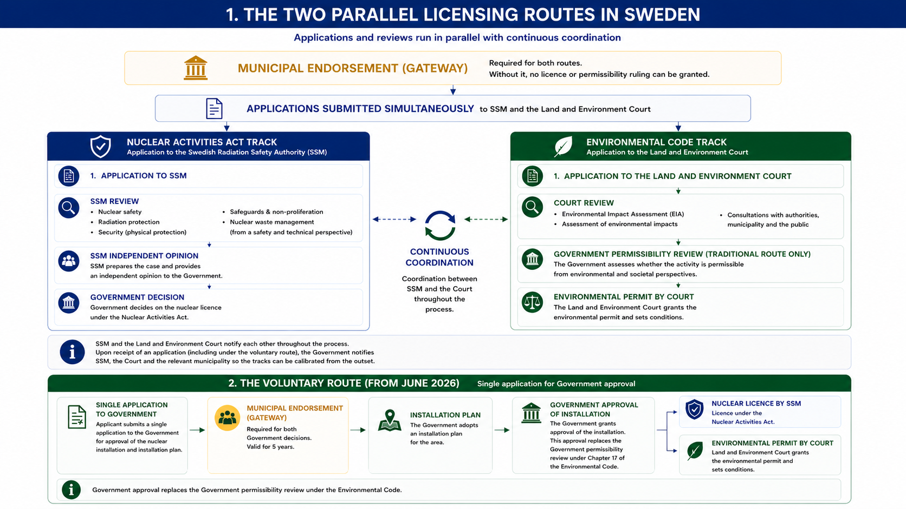
Licensing New Nuclear Facilities
Construction of a nuclear facility requires approvals under both the Nuclear Activities Act and the Environmental Code.
Sweden now provides two alternative regulatory pathways: the traditional licensing procedure and a new voluntary Government approval procedure.
The safety review by SSM and the environmental review by the Land and Environment Court are coordinated and proceed in parallel.
Municipal endorsement remains a prerequisite under both procedures

Slide 10
Pre-approval new 6-6d §§ Nuclear Activities Act
Decision by RSA on whether a nuclear facility's construction – in whole or in part – meets the requirements of the Nuclear Activities Act and Radiation Protection Act, including the detailed regulations issued under said Acts.
Valid for 5-15 years (decided case by case).
If positive and gained legal force, a pre-approval will be binding in the formal licensing assessment if application filed within the validity time set.
Not binding on legislative change, materially changed conditions, or incorrect information
Note: not a “type approval” (predefined framework criteria per reactor technology, certifying a standardised design). Instead, a pre-approval is a case-by-case ruling on a specific construction against existing law (type approval may , however, come into play for SMRs in the future).
Open for e.g. designers, suppliers, prospective and existing licensees; joint applications permitted

Slide 11
Radioactive Waste
Licence holders – responsible for waste management, decommissioning and dismantling.
The obligations are lifelong – they survive licence revocation, expiry or shutdown, ending only when the repository is finally closed.
The Financing Act (2006:647) requires operators to pay contributions into a state-administered fund for decommissioning and waste management and to provide financial guarantees.
SKB AB (jointly owned by all operators) handles waste from current reactors.
Forsmark deep repository for spent fuel – Government approval 2022; environmental permit 2024; SSM review ongoing.
New nuclear will require additional development of nuclear waste storage.
Reprocessing of waste?

Slide 12
Financing Reforms – State Risk-sharing
New Act on State Support for investments in new nuclear power (2025:587)
State loans for construction and trial operations
Two-way Contracts for Difference for routine operation phase
  State guarantees minimum price. If, om the other hand, electricity prices exceed a certain level, the difference shall be paid to the State
State Support covering up to 5 000 MW additional effect (equivalent to four large-scale reactors)
Operator/SPV applies for support to the Government
As today six pending applications; one set of agreements concluded in 2026
Subject to EU Commission state aid approval
New programme for the handling of additional radioactive wate; state to take a proportion of costs

Slide 13

Strengths/Risks New Regime
Plus +
  More predictability by early government involvement
  More possible sites for development
  State risk-sharing and earlier risk allocation
Minus -
  Parallel-track ambiguity (flagged by courts, EPA)
  Municipal veto can block good sites
  SSM capacity risk?
  Political risk?

Slide 14

Key Takeaways
A predictable licensing process is essential for investment decisions.
Regularory financing mechanisms are closely linked to the commercial viability of new nuclear projects.
Long-term management of radioactive waste remains a central legal responsibility and a key cost component.
Effective coordination between political decisions, financing and regulation is critical for successful implementation.
The entire regulatory system must be predicable and reliable over time.

Slide 15
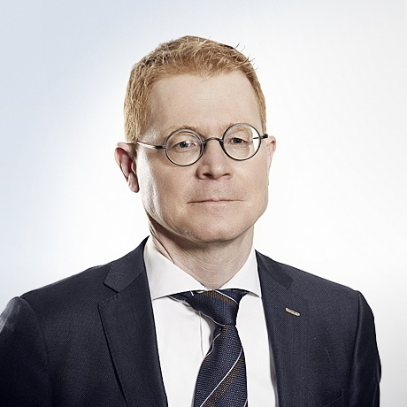
Mikael Wärnsby
Partner
+46 730 39 92 50
mikael.warnsby@lindahl.se
Thank you for your attention!

